Slide 1
Data Structures and Algorithms -3 (25CS2103E)
Legal Document Repository Efficient Search and Retrieval of Legal Documents Using Advanced Data Structures and Algorithms
Team Members:
Yasam Bhaarathi (2520030211)
Alluru Akshaya (2520030289)
Chada Hasika (2520030372)
Section – 08
Team no - 12
Under the Esteemed Guidance of
Dr. V. Sireesha
Professor, Department of CSE

Slide 2
Contents
Abstract
Introduction
Literature survey
Problem Statement and Objectives
Hardware and Software requirements
Results
Conclusion
Future Scope

Slide 3
Abstract
Law firms, courts, and legal organizations manage thousands of legal documents such as case files, contracts, affidavits, petitions, and judgments. Traditional document management systems often rely on manual filing or simple keyword searches, making document retrieval slow and inefficient.
The Legal Document Repository is designed as a centralized platform that securely stores, organizes, indexes, and retrieves legal documents. By implementing efficient indexing techniques and advanced string-searching algorithms such as Knuth-Morris-Pratt (KMP), Rabin-Karp, and Boyer-Moore, the system enables faster and more accurate document retrieval. The repository also minimizes duplicate records, improves document organization, ensures secure access through authentication, and increases productivity for legal professionals.

Slide 4
Introduction
The Legal Document Repository is a digital system developed to help law firms, courts, and legal organizations manage large collections of legal documents efficiently. It provides a centralized platform for storing and organizing case records such as contracts, petitions, affidavits, judgments, and case files.
The system allows users to quickly locate relevant legal records, view detailed case information, and identify related documents. It also maintains important case details such as case number, registration date and time, category, parties involved, witnesses, lawyers, judges, and case status.
The main aim of the project is to reduce the time and effort required to manage and retrieve legal documents, improve organization, and provide convenient access to important case information. This helps legal professionals handle records more effectively and supports faster legal research and case preparation.

Slide 5
Literature Survey
Area | Existing Approach | Limitation | Relevance to Our Project
Legal Document Management | Digital systems are used to store and organize legal records. | Large collections can make retrieval difficult. | Our system provides organized storage and access to case documents.
Pattern Matching | Keyword-based searching is commonly used to locate information in documents. | Basic searching can be inefficient for large text. | KMP is implemented for faster exact keyword matching.
Fuzzy Search | Approximate matching can handle spelling variations in user queries. | Exact search cannot identify misspelled terms. | Levenshtein Edit Distance suggests similar words.
Document Similarity | Similarity methods compare common terms between documents. | Finding related legal documents manually is difficult. | Jaccard Similarity identifies similar case documents.
File-Based Storage | Documents can be maintained as separate digital files. | Managing many files manually can become difficult. | The project uses .txt** files** to store case records and details.
Legal Case Retrieval | Users search through case information to find relevant records. | Searching different records can take time. | The system provides a centralized way to search and view legal documents.

Slide 6
Problem Statement and Objectives
Problem Statement
Legal organizations manage large volumes of documents.
Manual searching is time-consuming and inefficient.
Spelling errors can lead to unsuccessful searches.
Finding related documents is difficult.
Poor organization delays legal research.
Secure management of confidential records is essential.
Need: A secure and efficient system for quick and accurate legal document retrieval.
Objectives
Store and organize legal documents systematically.
Provide fast and accurate document searching.
Support searches with spelling mistakes.
Identify similar and related documents.
Maintain complete case information.
Provide simple and convenient document access.

Slide 7
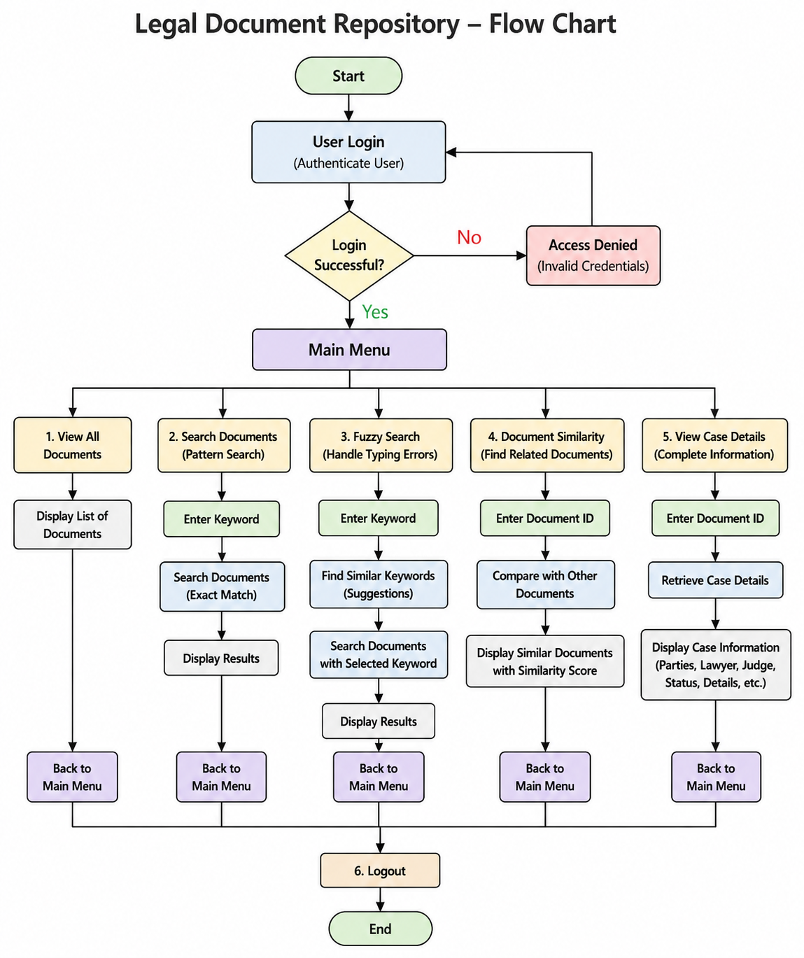
Flow Chart

Slide 8
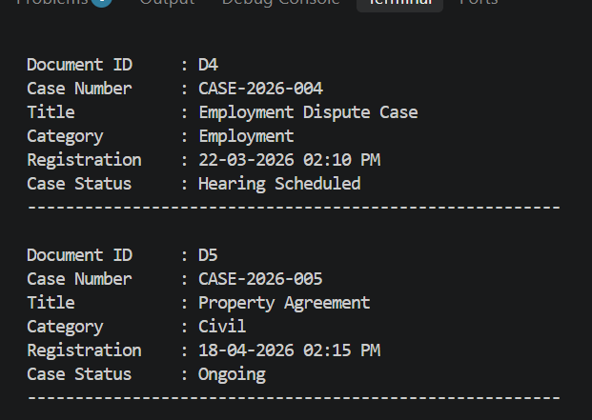
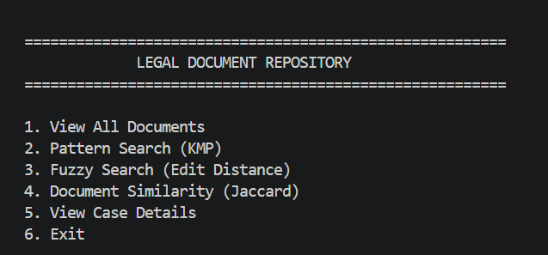
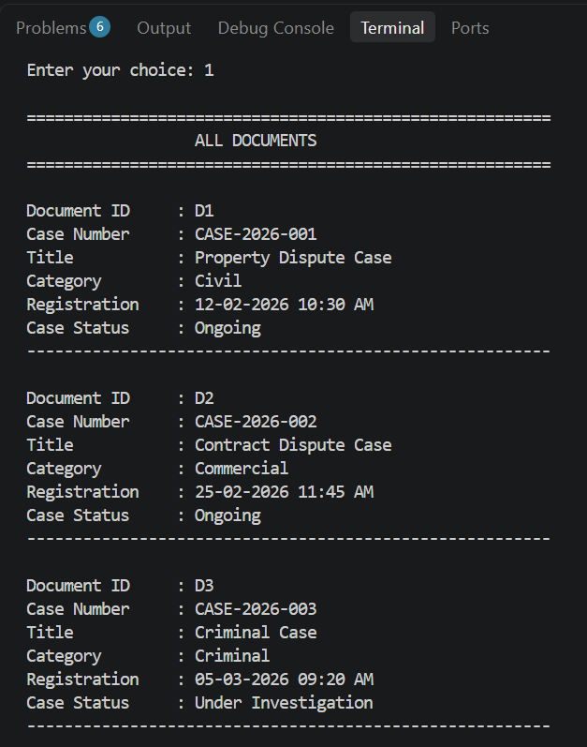
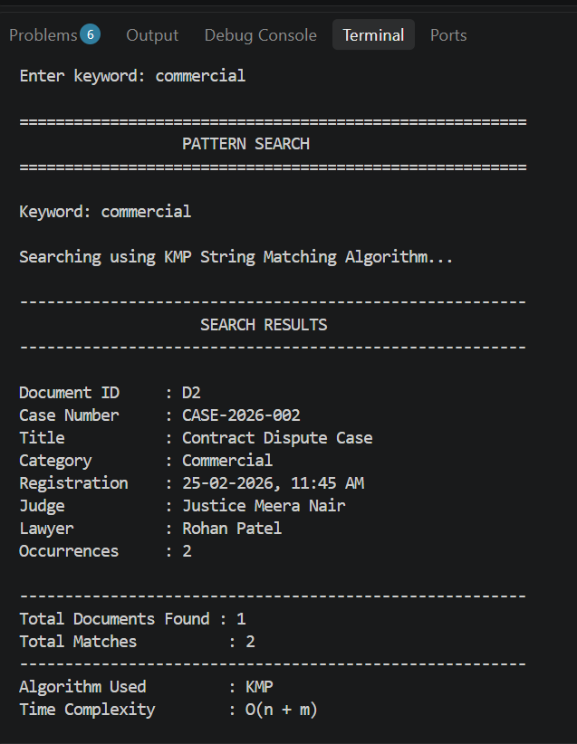
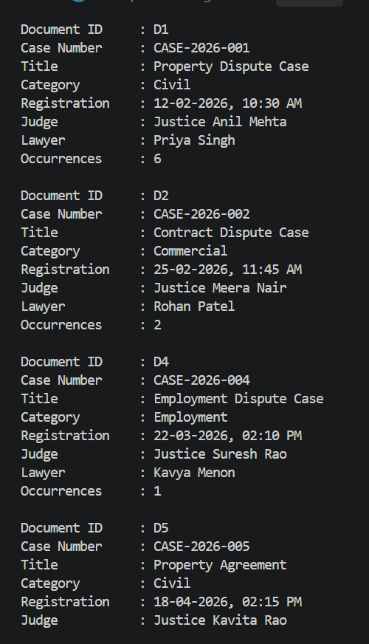
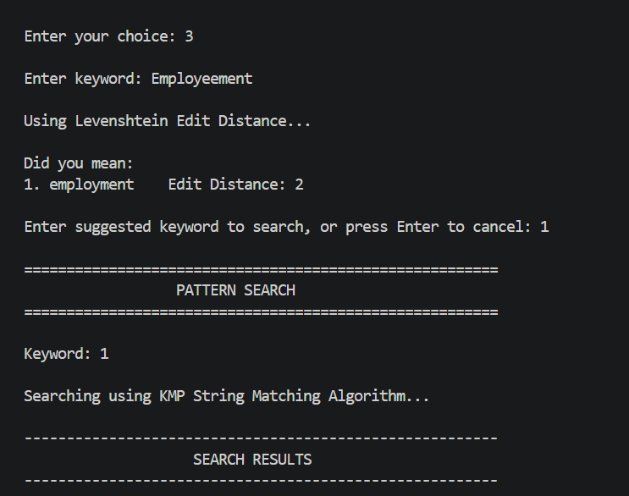
Results

Slide 9
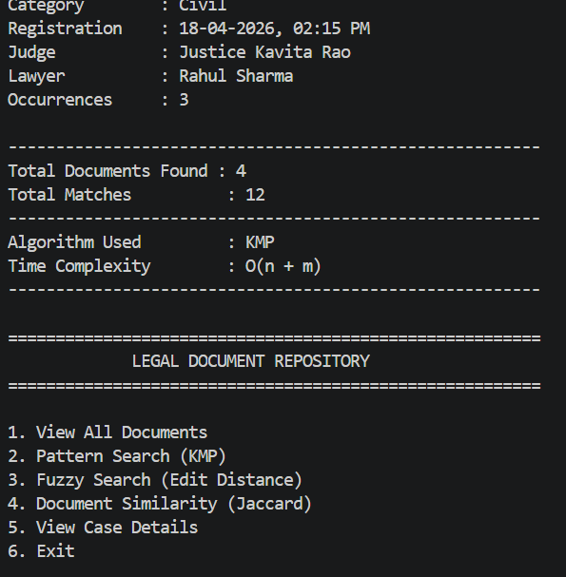
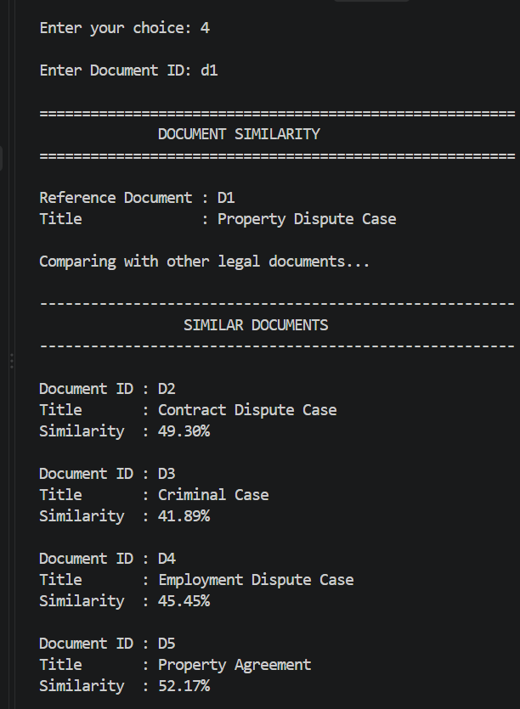
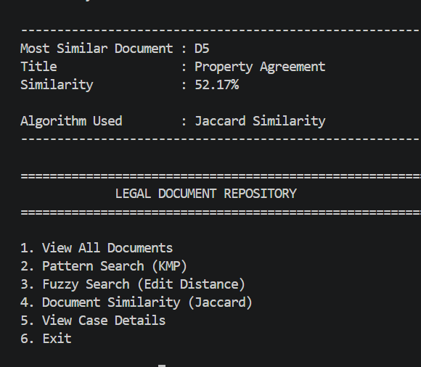
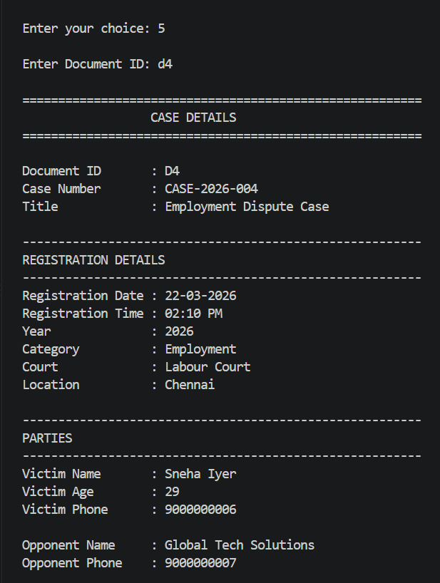
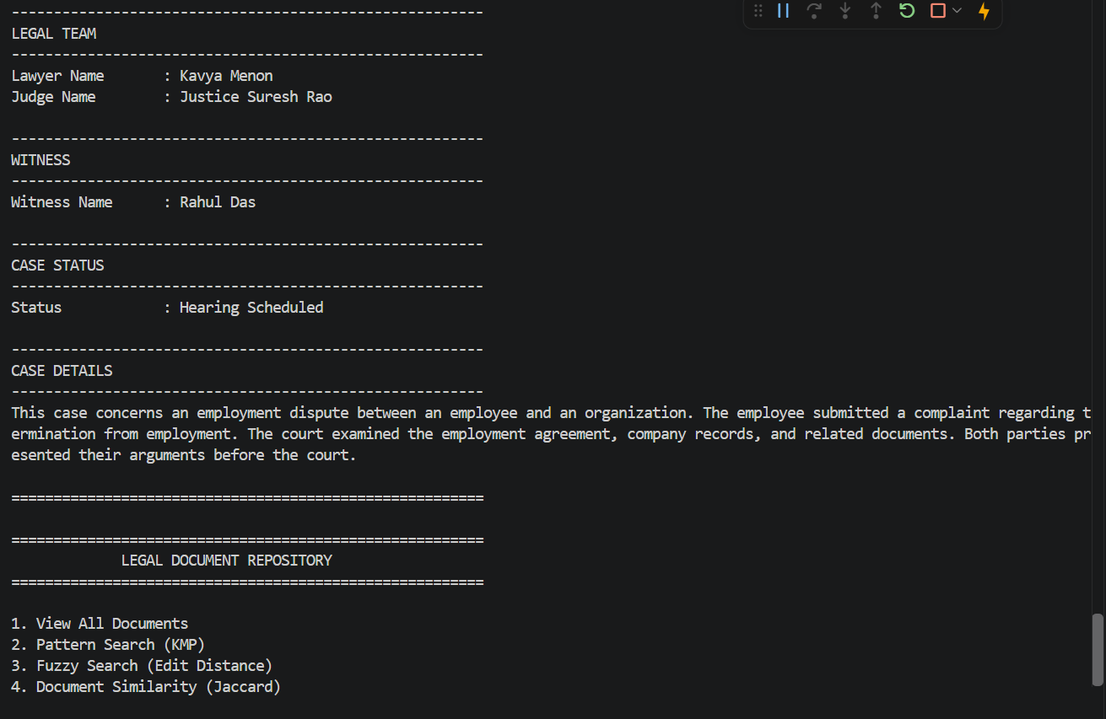
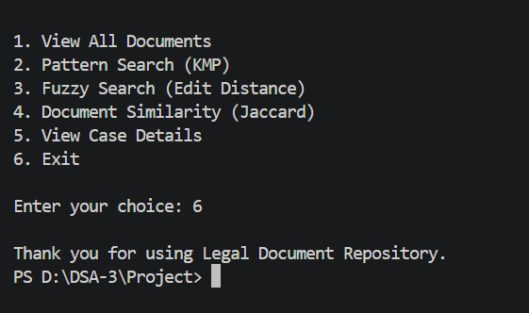

Slide 10
Hardware and Software requirements
Hardware Requirements | Software Requirements | Development Tools
Intel Core i3 or above | Windows 10/11, Linux, or macOS | Java
4 GB RAM or above | JDK 8 or above | Eclipse / IntelliJ / NetBeans
500 MB free storage | Java Standard Libraries | VS Code
Standard Keyboard & Mouse | File Handling (.txt) | Console-based Application
Standard Monitor | Java I/O Support | Java Development Environment

Slide 11
Conclusion
The Legal Document Repository provides an efficient and organized solution for managing large volumes of legal records. It helps users store, search, retrieve, and compare documents while maintaining important case information in a structured manner.
The system reduces the effort and time required to locate relevant legal documents and makes case information easier to access. It also provides support for spelling variations and identification of related documents, making the retrieval process more effective.
Overall, the project demonstrates how a simple and user-friendly legal document management system can improve document organization, retrieval, and accessibility for law firms, courts, and other legal organizations.

Slide 12
Future Scope
Multiple Algorithms – Implement and compare KMP, Rabin-Karp, Boyer-Moore, and Suffix Array algorithms.
Advanced Search – Search using names, keywords, dates, locations, and case-related details.
OCR Integration – Enable searching within scanned PDFs and image-based documents.
Result Ranking – Display the most relevant documents first.
AI & NLP Search – Support semantic search to understand the meaning of user queries.
Automatic Categorization – Classify documents into categories such as property, criminal, civil, and agreements.
Cloud Storage – Provide secure access and storage from multiple devices.
User Authentication – Add role-based access control to protect confidential documents.

Slide 13
Thank you

